Slide 1

IBM Data Science: Capstone Project
Are you looking to relocate in Europe?

Slide 2
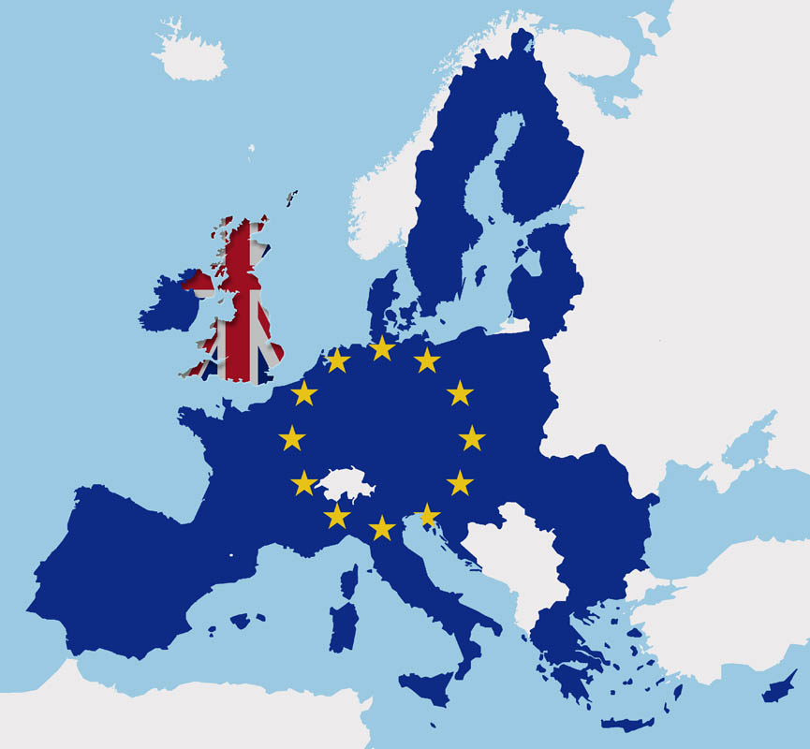
Background
Europe with its Eurozone is a perfect place for people who likes work travelling. My friend, Bart, currently is living in Warsaw, Poland and looking to move to some other city in Europe that is as comfortable as Warsaw but with higher income. I think Bart is not alone with such idea in mind, hence categorizing European cities by similarities is great topic that I might use myself as well.

Slide 3

Idea
The goal here is to build a clustering model to group European cities based on certain parameters. Leveraging Foursquare API I gathered top cities venues, because variety of the restaurants and places you can go is one of the important factors feeling comfortable in the city. Also, the important factor is weather, even though there is plenty of restaurants out there if its showring outdoor. I know Bart likes the weather in Warsaw, hence I gathered some main weather statistics for each city. And of course, Bart is looking for city with higher income, GDP per capita as one of the main indicators of higher salaries is important indicator.

Slide 4

Data
Data for the research comes from various places:
European data bank: https://ec.europa.eu/eurostat - provided population and GDP figures
Geolocation will mainly be pulled from Foursquare (better precision) and from geopy library
City venues – Foursquare
Annual weather report – to be scraped from https://weatherspark.com

Slide 5
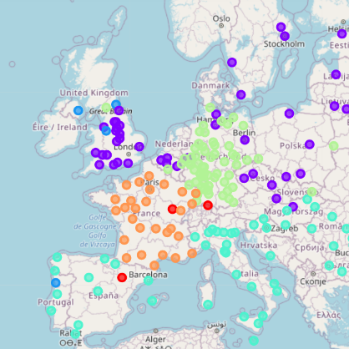
Clustering
After testing different number of clusters, I end up with 6 of them. And from the map view I would say that the clustering has weather statistics and GDP per capita. Some groups are located almost strictly on the territory by certain countries. However, I think venues categories specific to region might played a big role.

Slide 6

Final Results
I am glad to advise Bart that he can plan to go to any of the below cities:
Manchester, Cambridge, Oxford, Exeter, Ipswich, Malmö, Stockholm, Göteborg, Düsseldorf, Leicester, Bruxelles, Gent, Coventry, Antwerpen, Middlesbrough, Bristol, Portsmouth, Kiel, Hamburg, Cardiff, Leeds, Uppsala, Southampton, Colchester, Ostrava, Doncaster, Bratislava, Swansea, Plzen, Liège, Praha, Brno, Berlin

